Slide 1
IBM Capstone: Best Location for Steakhouse in Toronto
By Shaheer Shahab

Slide 2
Introduction
A chef I know wants to open up a high-end steakhouse in Toronto and has hired me as a consultant to help him decide which neighborhood would be the best place to open it

Slide 3
Problem Description
Where should the chef open up his high-end steakhouse in the city of Toronto that will guarantee a lot of customer?

Slide 4
Requirements
The steakhouse needs to be accessible to people who can afford it (have a lot of money)
The steakhouse needs to be in a well-populated area

Slide 5
Data Needed
Toronto neighborhoods by their postal code https://en.wikipedia.org/wiki/List_of_postal_codes_of_Canada:_M
Latitude/Longitude coordinates https://cocl.us/Geospatial_data
Toronto neighborhood populations by postal code https://www12.statcan.gc.ca/census-recensement/2016/dp-pd/hlt-fst/pd-pl/Tables/File.cfm?T=1201&SR=1&RPP=9999&PR=0&CMA=0&CSD=0&S=22&O=A&Lang=Eng&OFT=CSV
After tax income for Toronto neighbourhoods https://en.wikipedia.org/wiki/Demographics_of_Toronto_neighbourhoods
Restuarants and venues https://api.foursquare.com

Slide 6
Methodology
I loaded and then imported Toronto Postal Code Data
Merged Postal Codes with their corresponding populations
Merged Postal Codes with Incomes
Merged geospatial coordinates with Toronto postal codes
Merged most common venues visited with Population, income data to create new data frame
Used folium to plot new data frame on a map with coordinates for the best location

Slide 7
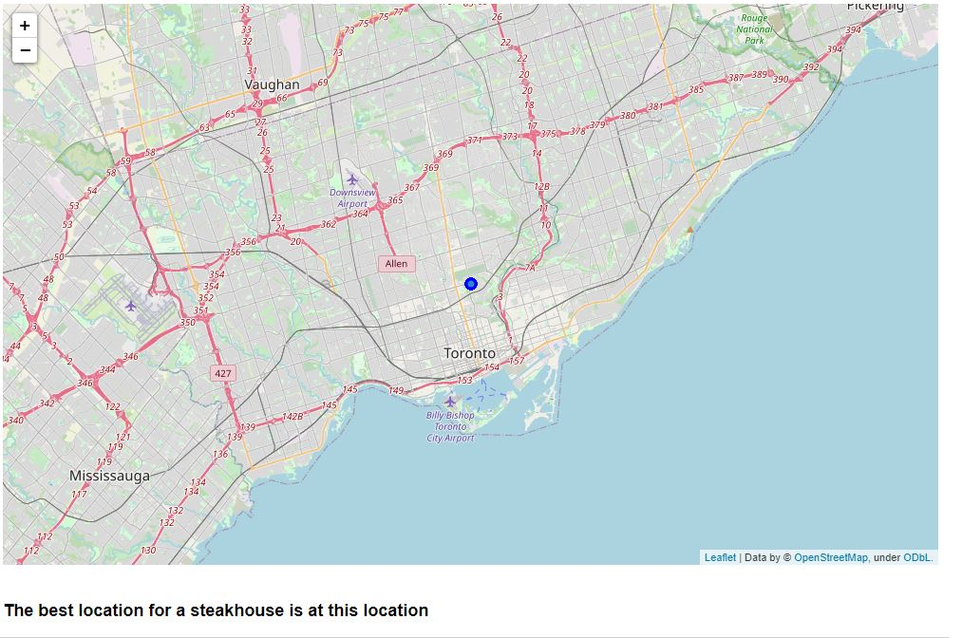
Results
I was able to find a location that would be best suited for a Steakhouse in the neighborhood of Moore Park as displayed here

Slide 8
Discussion
Looking at the average incomes of each neigbhorhood showed me that the wealth of Toronto is concentrated in the central / downtown area which makes sense as this is the case for many other cities in the world as those areas have the highest land values and therefore only the people in high income brackets are able to afford living there.
I was originally going to go focus solely using clusters but it didn’t make much sense for me to do so as I just needed to find the best location in the entire city as per my self-given prompt

Slide 9
Conclusion
Using the tools I have used, I can say with definite certainty that my results were accurate and based on these variables and data, this location that was found is the best area for a high-end steakhouse.

